Slide 1

CHEMISTRY MINI PROJECT

Slide 2

NAME : C.ASWINI
BRANCH : BE-CSE
SECTION : A
REG.NO : 111724102016

Slide 3

POLYMER - POLYVINYL ACETATE
SOLVENT-WATER

Slide 4
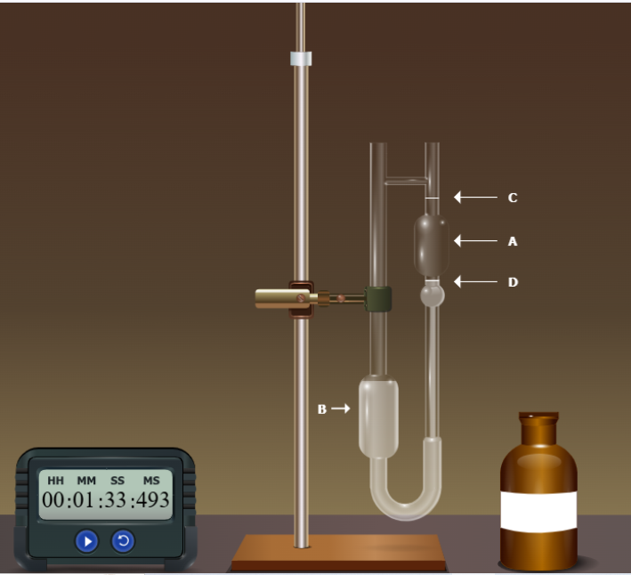
solvent-water

Slide 5
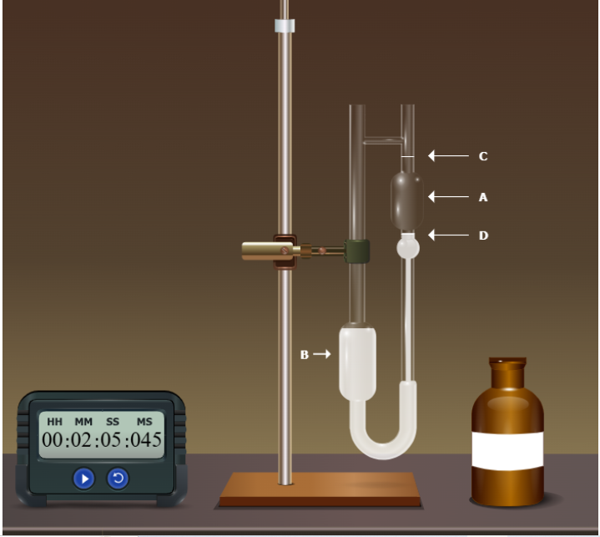
CONCENTRATION – 0.02

Slide 6
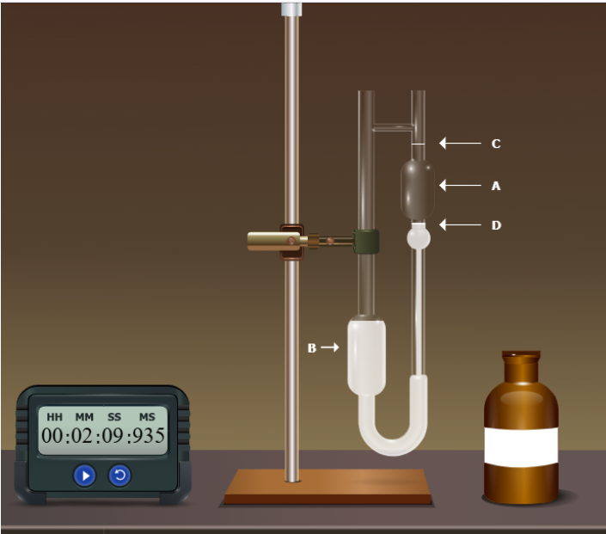
CONCENTRATION – 0.04

Slide 7
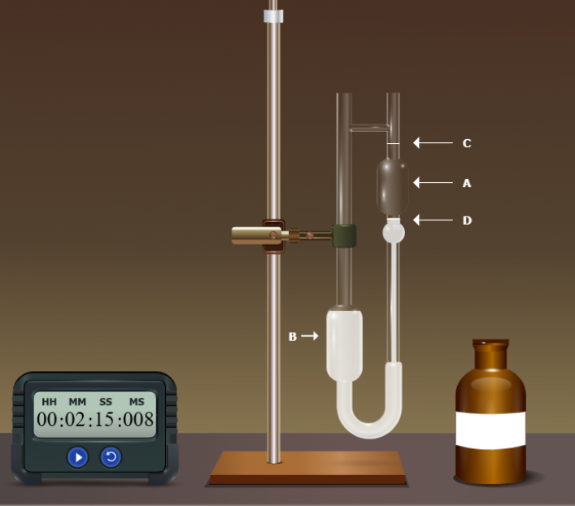
CONCENTRATION – 0.06

Slide 8
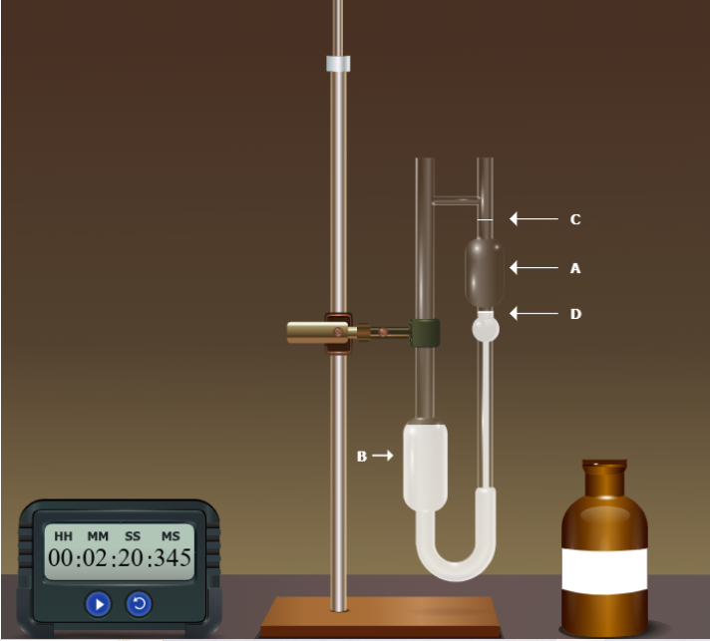
CONCENTRATION – 0.08

Slide 9
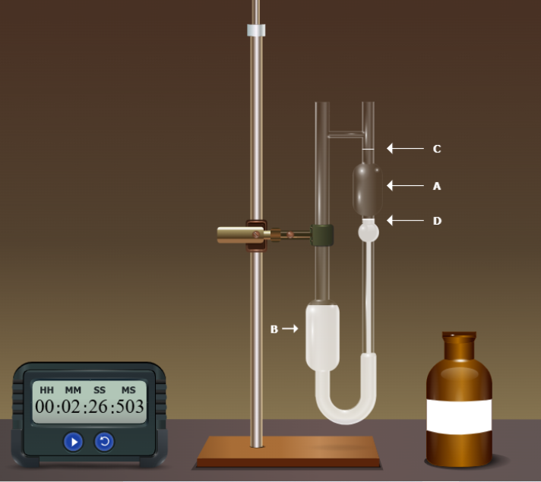
CONCENTRATION – 0.01

Slide 10
SI.NO | CONCENTRATION OF THE POLYMER | FLOW TIME T ‘SEC’ | Պ/Պ0=t/to=Պr | Պsp = Պr-1 | Պ red=Պsp/c
1. | 0.02 | 125.045 | 1.3374 | 0.3374 | 16.87
2. | 0.04 | 129.935 | 1.3897 | 0.3897 | 9.74
3. | 0.06 | 135.008 | 1.4440 | 0.444 | 7.4
4. | 0.08 | 140.345 | 1.5011 | 0.5011 | 6.26
5. | 0.01 | 146.503 | 1.5669 | 0.5669 | 56.69

Slide 11
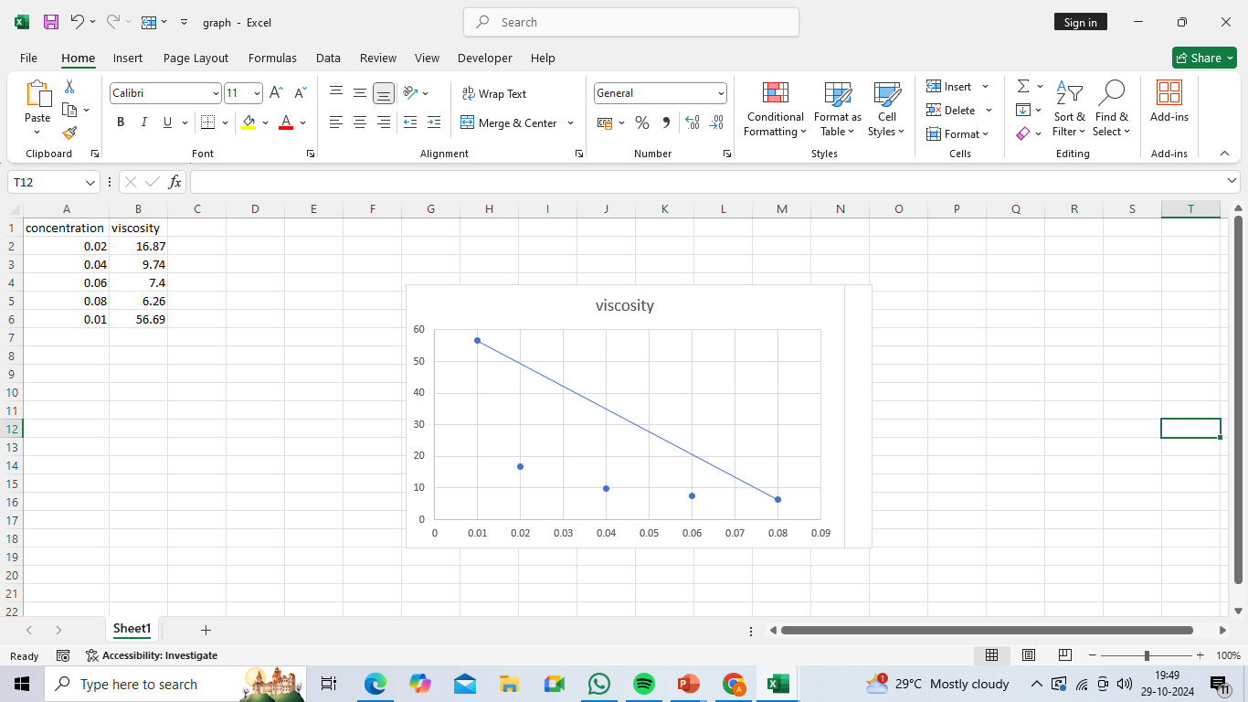
Graph

Slide 12
[Պ] = kMª
M=[[Պ] / k]^{1/a}
For Water, k= 1.0×10−3 dL/g, a=0.8
Պ=kMª
Պ=58
Molecular weight of the polymer
M=[ [Պ]/k]^{1/a}
M=[[58]/1.0*10⁻³]^{1/0.8}
M=0.0725
Molecular weight of the polymer = 0.0725

Slide 13


